Slide 1
B100 APTIV project weekly work progress report
Date – 28/05/2020 To 25/05/2020

Slide 2
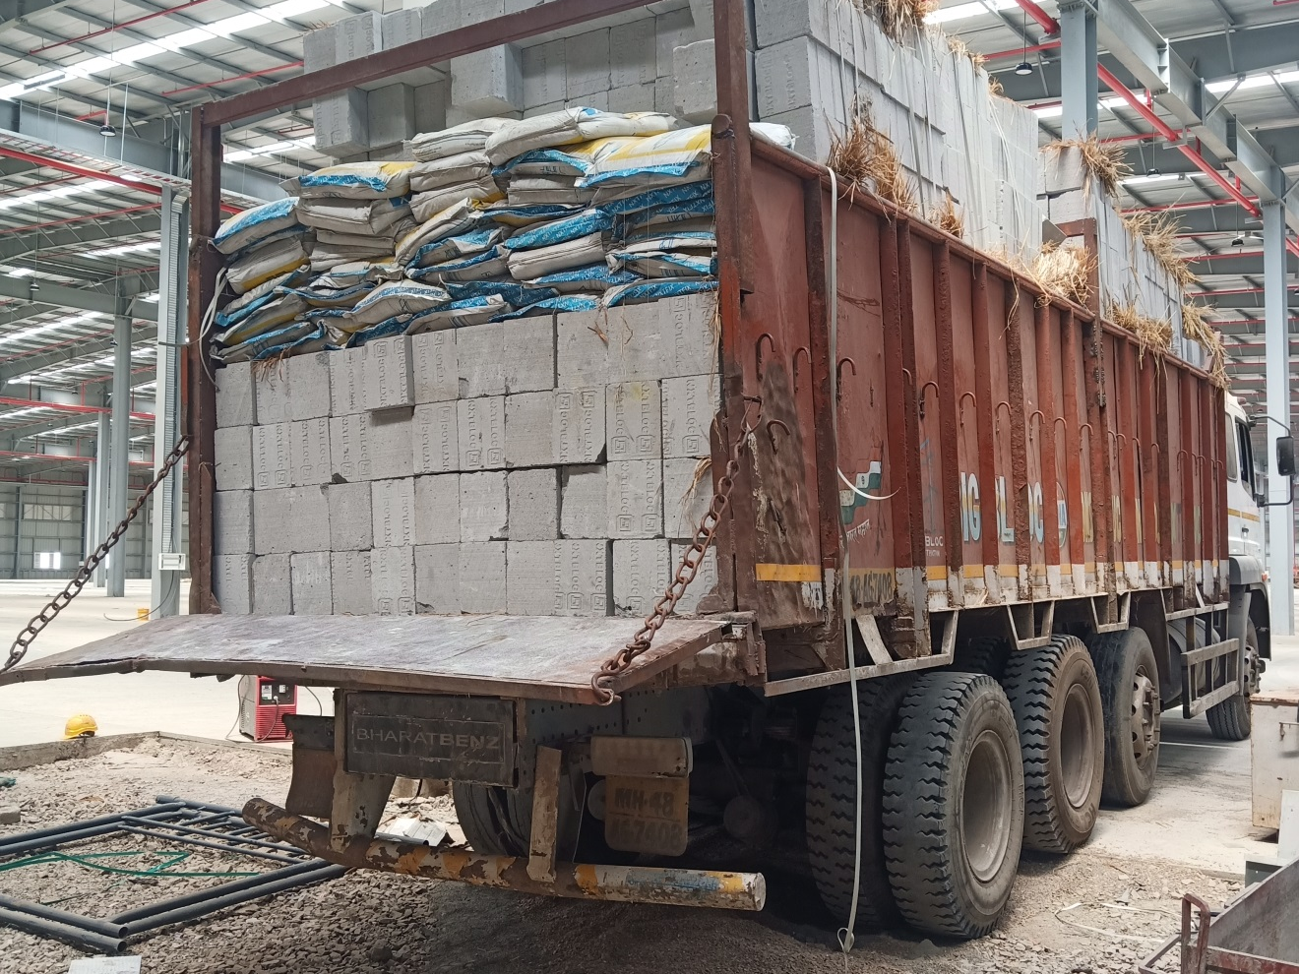
B100 APTIV Project Siporex block unloading

Slide 3
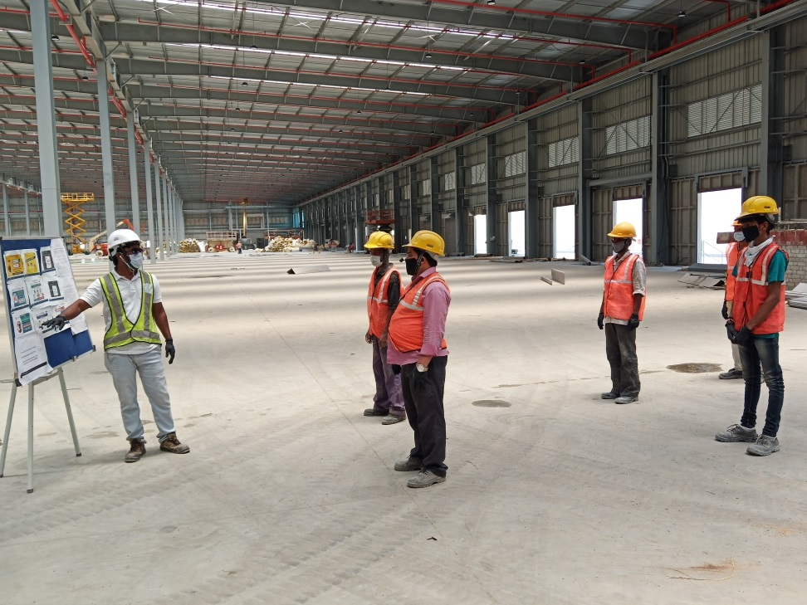
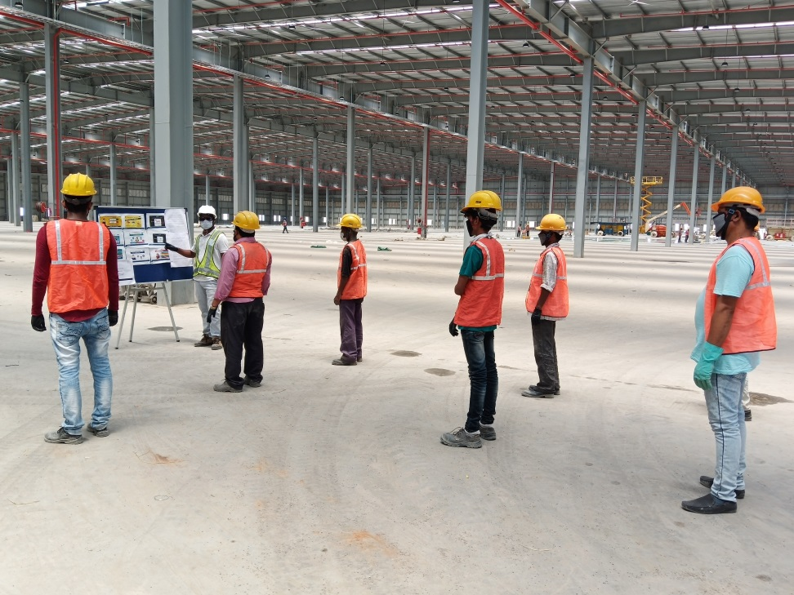
Site TBT

Slide 4
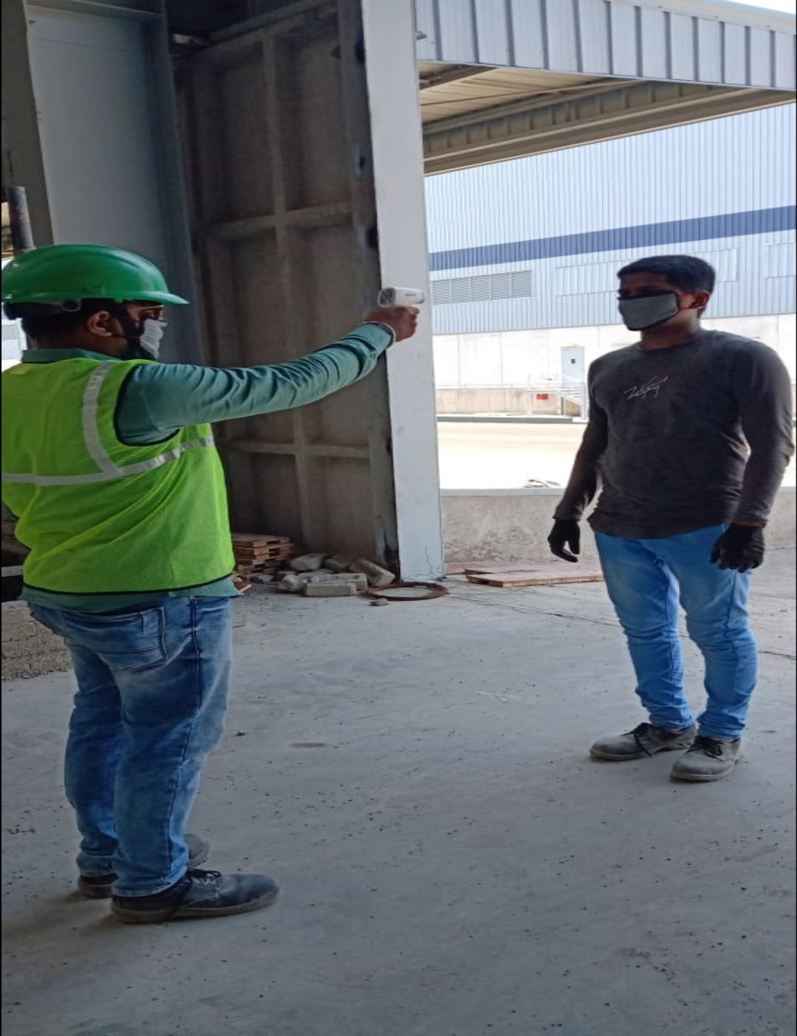
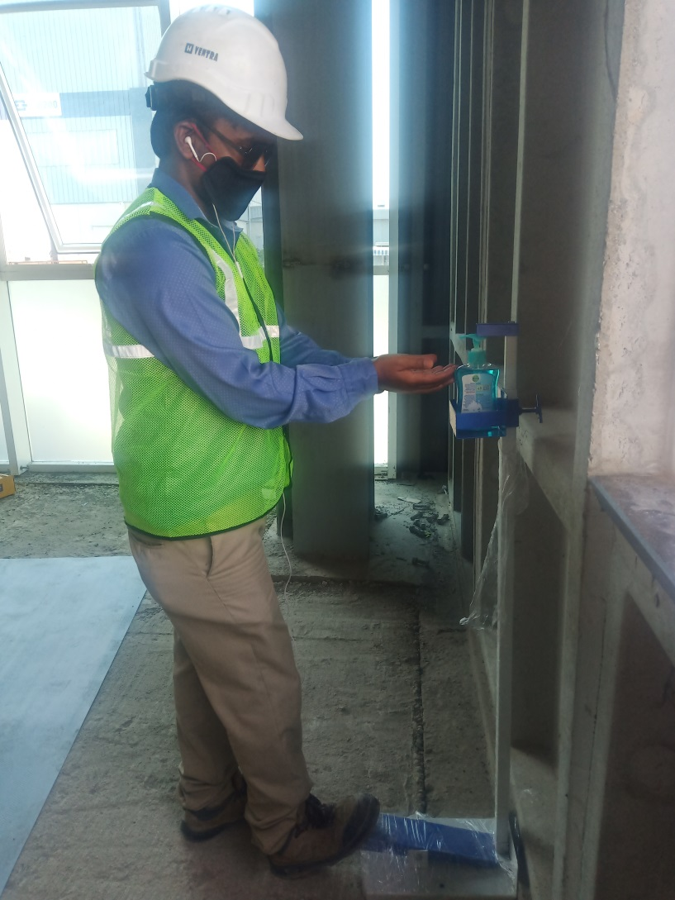
Temperature test & Hand Sanitization before start wok at site

Slide 5
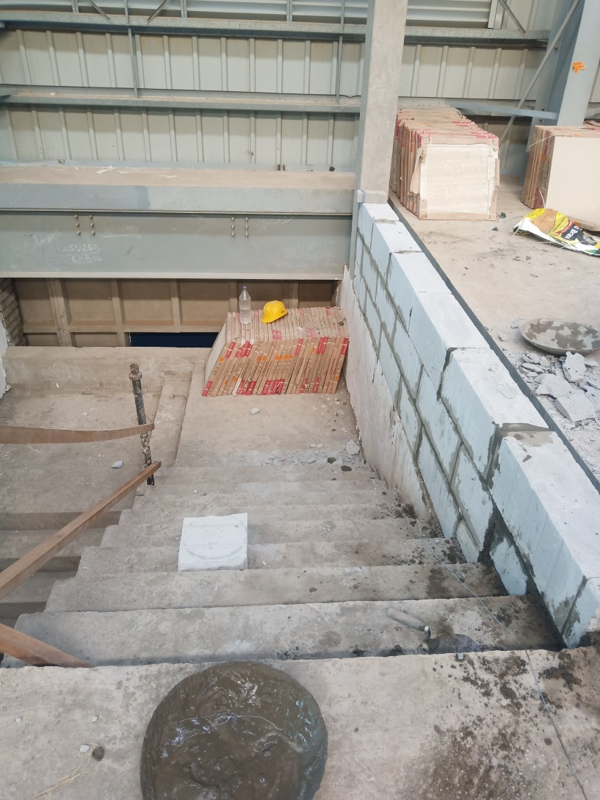
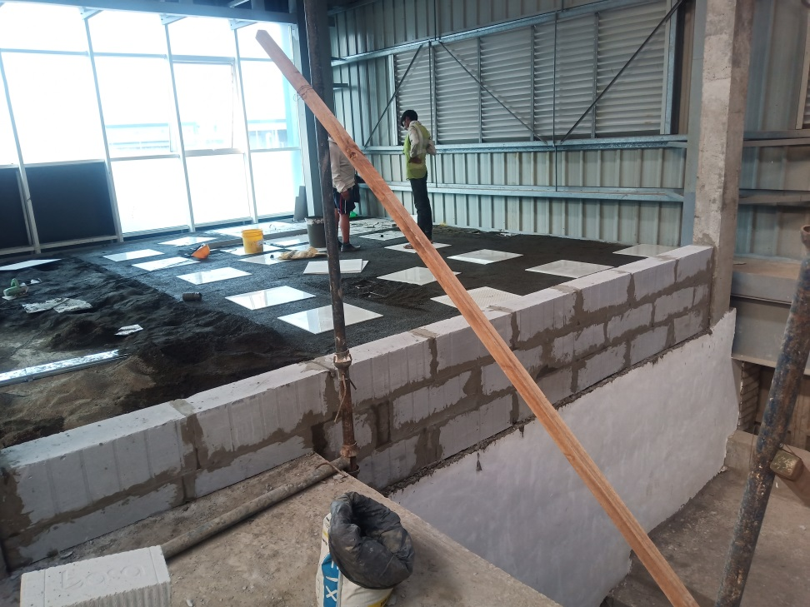
Staircase RH & LH block wall work in progress

Slide 6
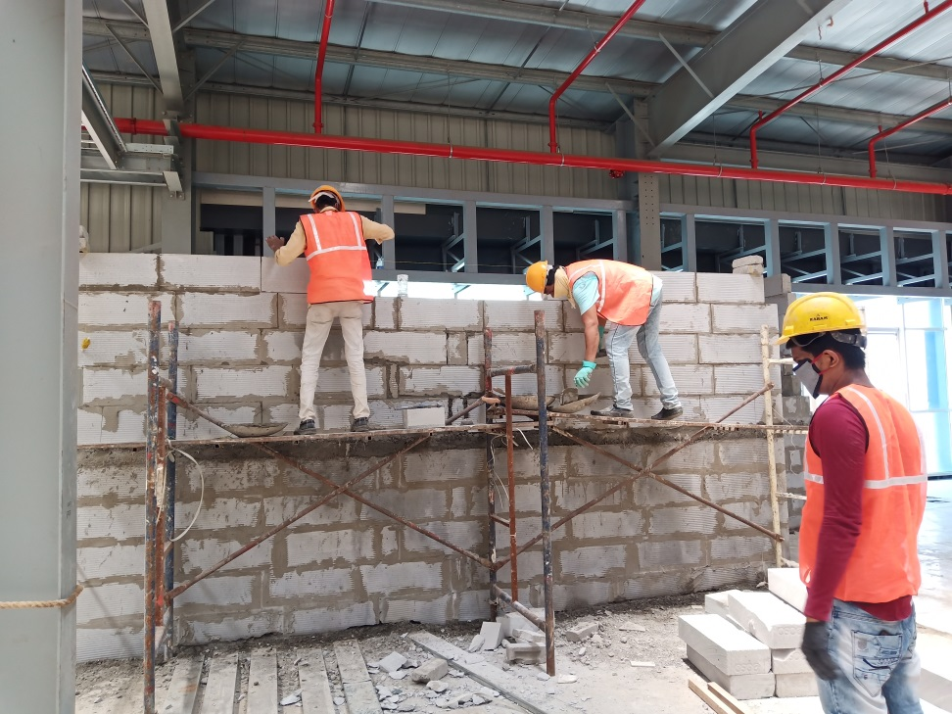
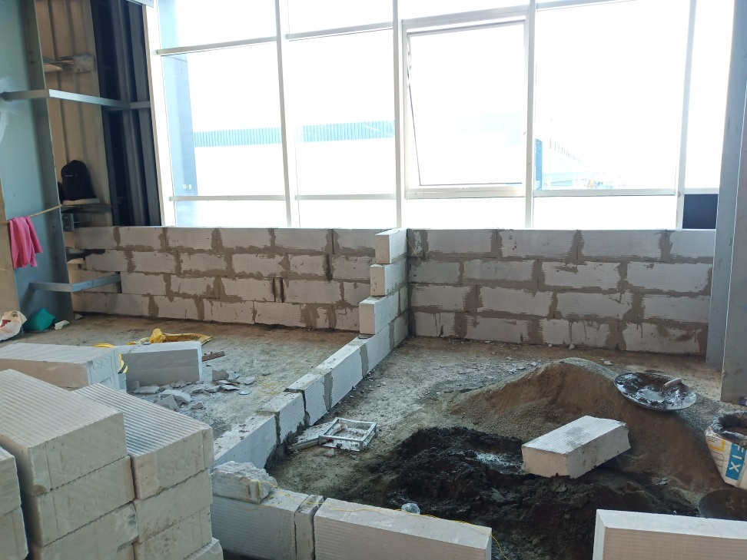
Server room & Hub room block wall work start and in progress

Slide 7
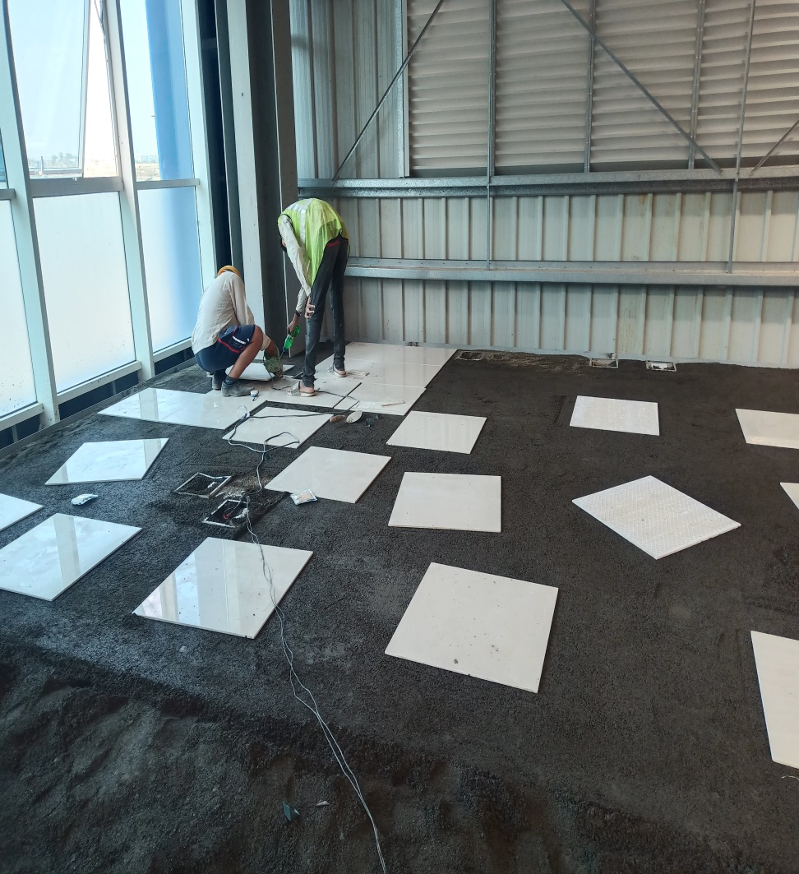
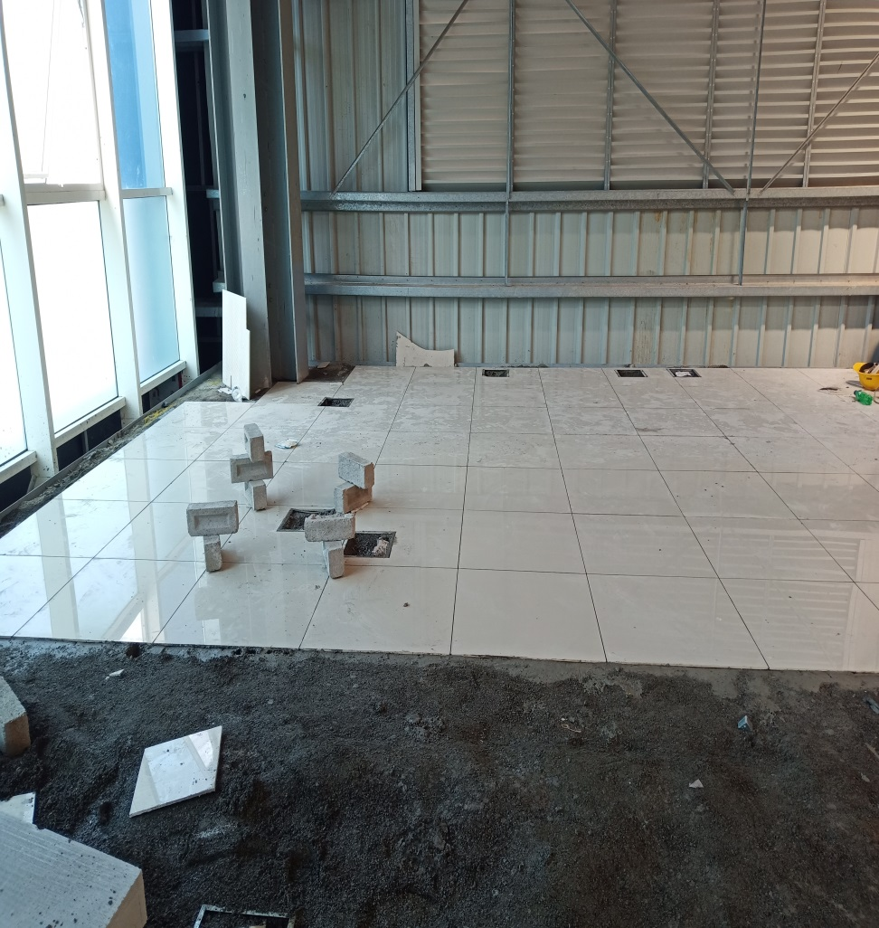
Mezzanine floor MQB room flooring tiles work start and in progress

Slide 8
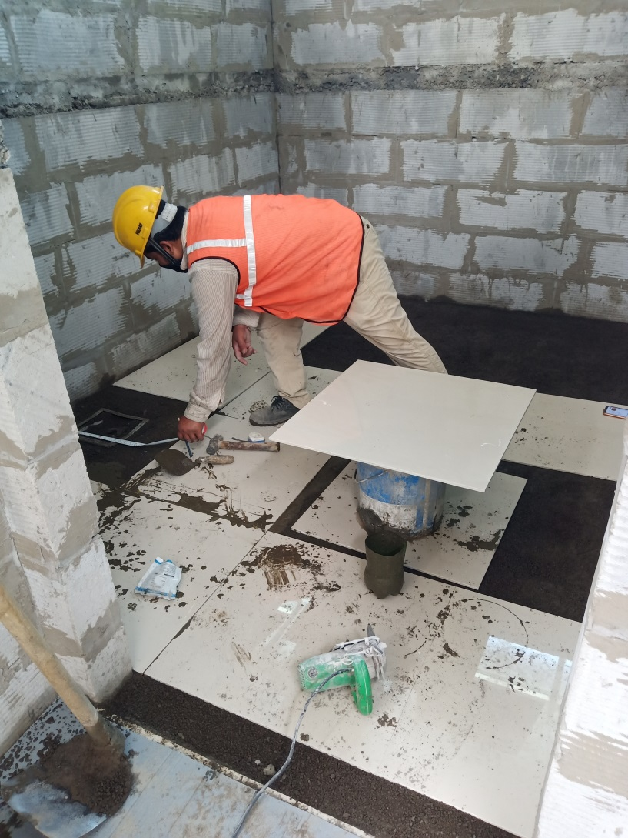
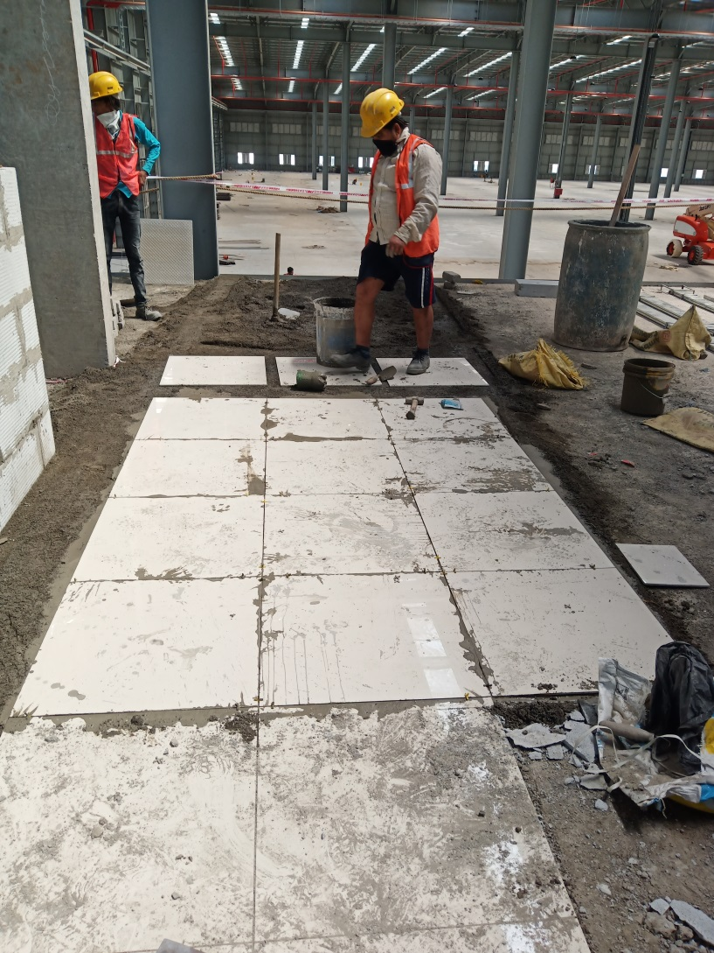
Hub room & Passage flooring tiles work in progress

Slide 9
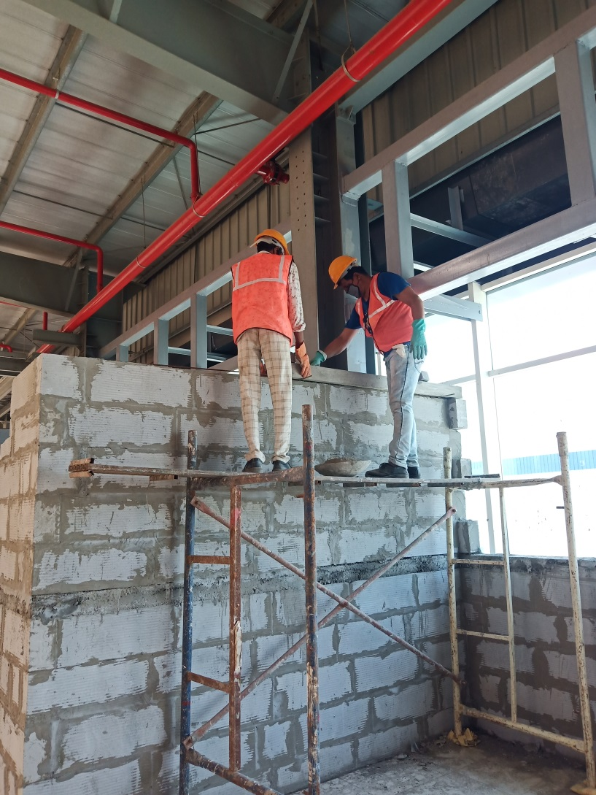
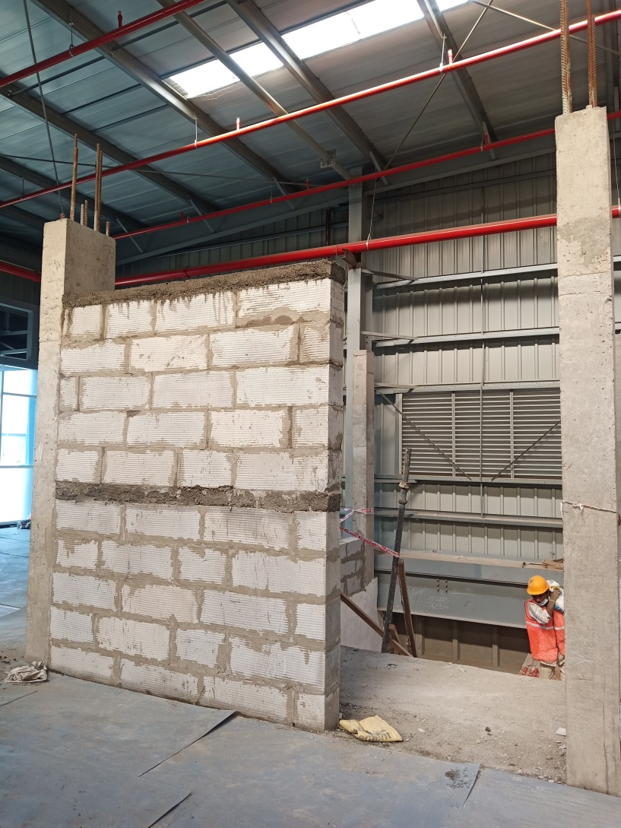
Hub room & 1st floor entry wall work in progress

Slide 10
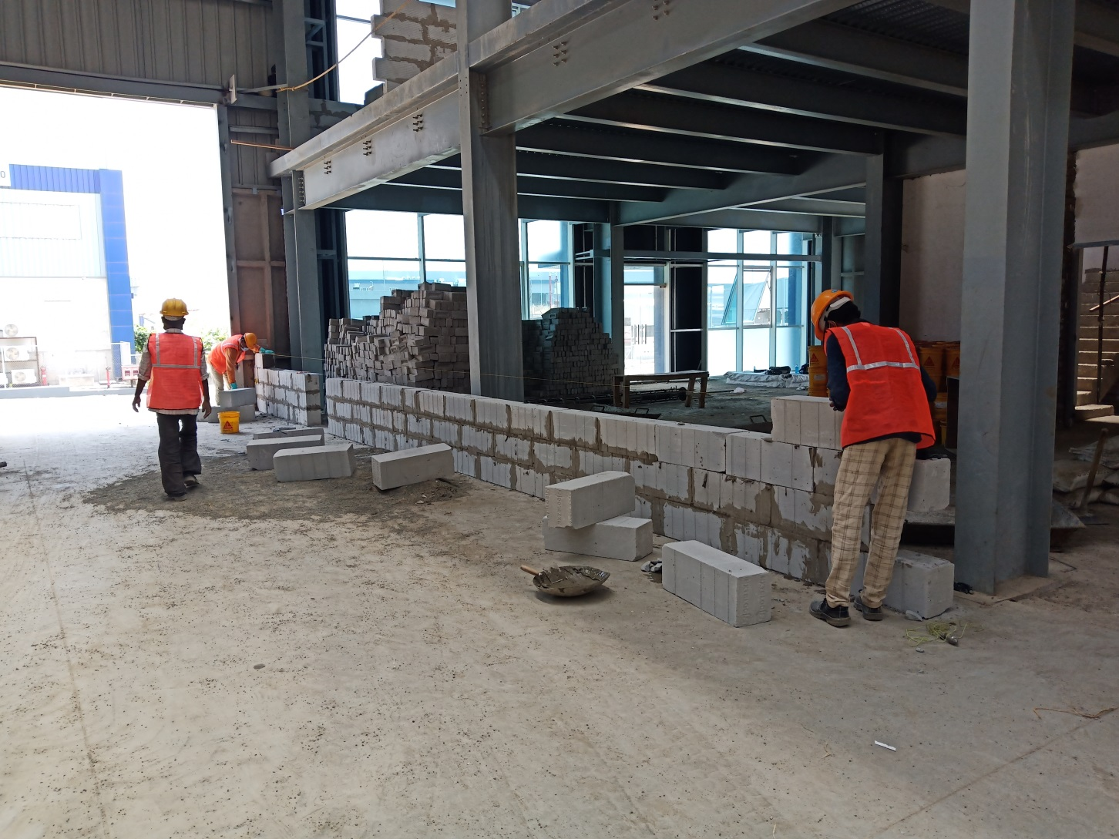
Ground floor shop floor side block wall work start and in progress

